Slide 1


Data Processing
Pipeline
End-to-end 7-step framework for
harmonized analytics
December 09, 2025

Slide 2

Table of Content
Pipeline Overview
Sample Mapping Table
Workflow Diagram
Success Metrics

Slide 3



Pipeline Overview
Objective: Turn heterogeneous raw data from diverse sources into a single, trusted, and harmonized master dataset for downstream analytics.
Scope:
Comprehensive 7-step process covering the entire lifecycle: from initial raw Ingestion through AI Reconstruction to final Export.
Key Outcomes:
High Data Quality
Semantic Consistency
Full Lineage & Trust

Slide 4
Sample Mapping Table
Key fields: Region, Category, Brand, Channel, Survey Wave, Age Group.
Master Mapping Table Example:
Source Field | Source Value | Canonical Field | Canonical Value | Notes
Qcountry | 238 | Country | Australia | Mapped country code to name
QLanguage | 133 | Language | English | Standardised language code
AGE | 61 | Age | 61 | Direct mapping
SEX | 1 | Gender | Male | Converted numeric to text
DEMO_REG | 1621 | Region | Asia-Pacific | Applied region mapping
DEMO_EDUC | 274 | Education | Graduate | Mapped education code
DEMO_OCC | 520 | Occupation | Professional | Mapped occupation code
Q1_CAT_AU_CC_scale#1 | 4 | Satisfaction Score | 40 | Converted 1-10 scale to 0-100
Q1_CAT_ET_CC_scale#2 | 2 | Satisfaction Score | 20 | Scale conversion
WAVE | 202209 | Survey Wave | 2022-Q3 | Formatted wave
CurrentYear | 2022 | Year | 2022 | Direct mapping
CurrentMonth | 9 | Month | September | Mapped month number to name
AGE_GROUP_1 | 4 | Age Group | 45-54 | Mapped age group code
AGE_GROUP_2 | 6 | Age Group | 55-64 | Mapped age group code
Q5_PBAT_SPONT_AWARE_TOM | NaN | Brand Awareness | Unknown | Missing value handled

Slide 5
Process Flow Diagram
Step-by-Step Guide: Possible following steps
1.
2.
3.
Ingestion
Validation Agent
Harmonization Agent
Import raw datasets into a controlled staging zone.
Auto-validate schema and detect anomalies before processing.
Standardize and align data into a unified structure.
6.
5.
4.
QC Agent
Consolidation
Reconstruction Agent
Auto-validate final metrics and structural integrity before output.
Auto-merge old and new data into a single, deduplicated master dataset.
Infer missing attributes to complete incomplete records.

Slide 6
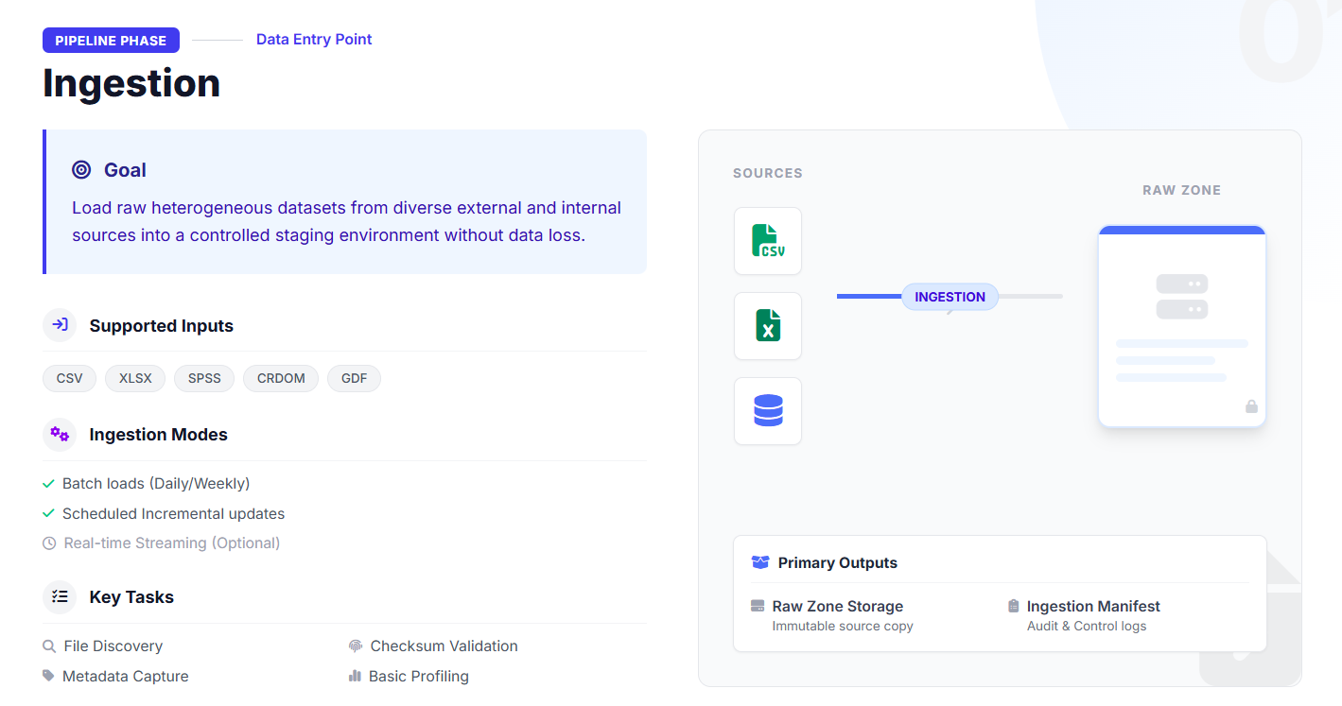

Slide 7
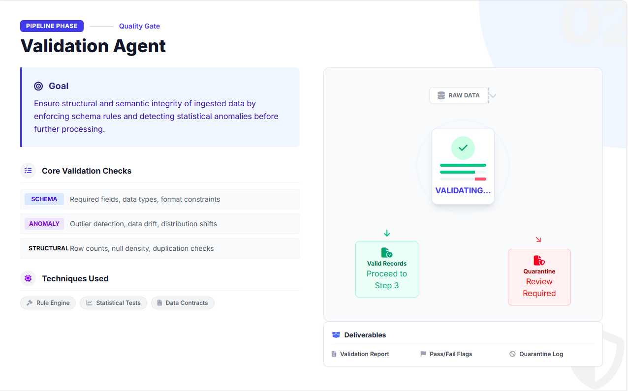

Slide 8
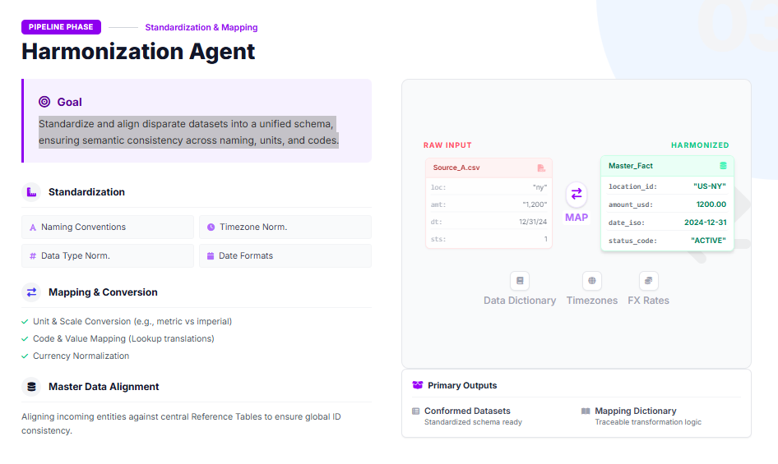

Slide 9
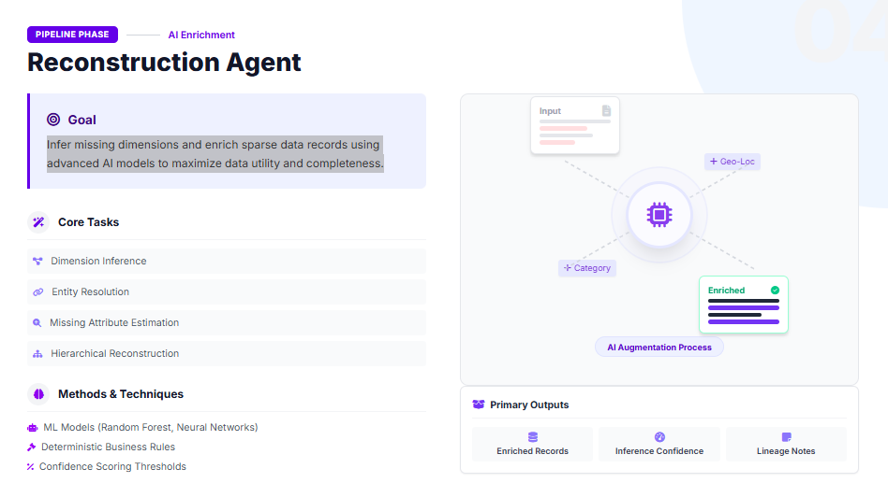

Slide 10
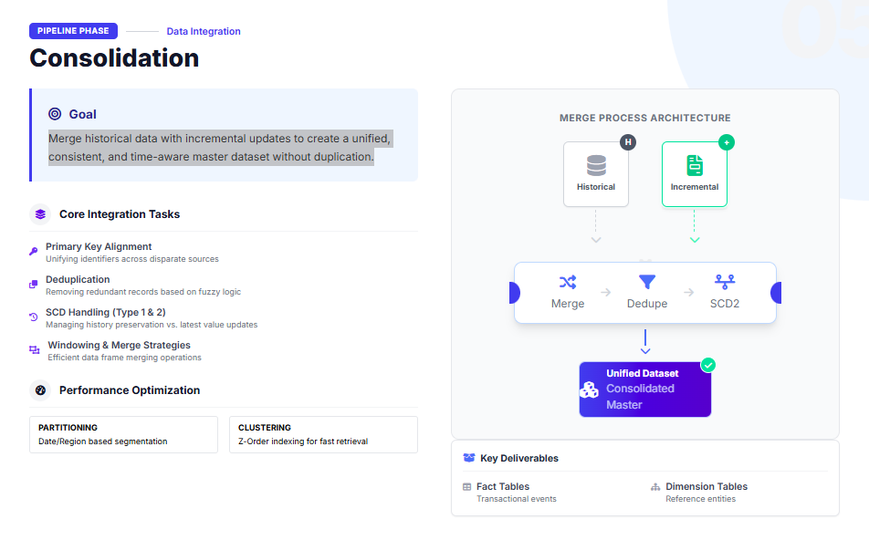

Slide 11
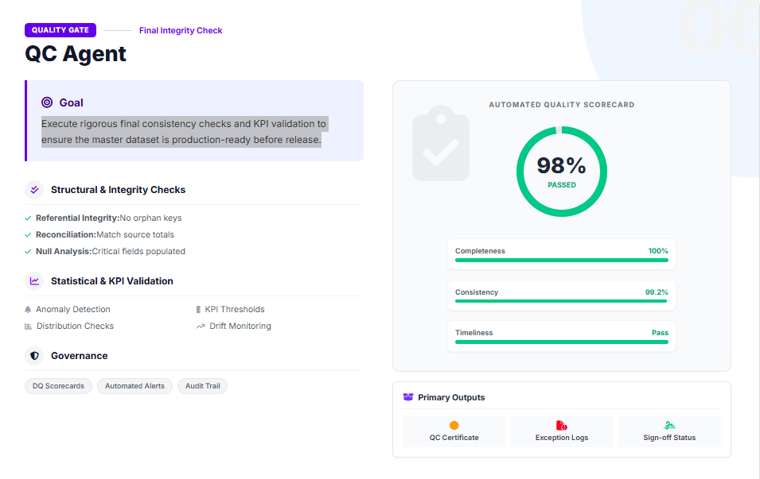

Slide 12
Success Metrics
Mapping Accuracy Target: >=95% 1. Focus on the AI’s Ability to correctly suggest data field mapping 2. This is the first line of defence against integration errors. 3. Our Target of greater than 95% ensures we minimize manual correction efforts
Schema Consistency Target: 100% 1. Emphasize the requirement for perfect uniformity - a fundamental standard for data integration.
2. It has an absolute target of 100%, as inconsistency breaks downstream analysis.
Missing Value Reconstruction Target: >=90% 1. Highlight the AI's role in intelligently imputing missing data points, crucial for complete datasets.
2. The 90% target for Reconstruction means our agent must provide high-confidence, accurate estimates for missing data.
Processing Time Reduction Target: 70–90% faster 1. This metric is critical for demonstrating the business value of the AI system.
2. The 70% - 90% faster target translates directly into reduced operational costs and faster time-to-insight for our teams.
Anomaly Detection Precision Target: >=90% 1. Focus on the system's ability to accurately flag structural or drift issues without excessive false positives.
2. High precision ensures we catch genuine data drift - a sign of changes in the source data.

Slide 13
Summary & Next Steps
Key Benefits | To Finalize | Deployment Plan
Consistency: Unified data standards across all sources eliminate silos and discrepancies. | Service Level Agreements (SLAs) Data Contracts with Providers KPI Definitions & Thresholds Monitoring & Alerting Rulescorrectly | Phase 1 Pilot Launch Deploy to priority domain (Sales). Manual validation.
Analytics Ready: High-quality, harmonized datasets ready for immediate BI and ML consumption. |  | Phase 2 Automation Enable Airflow DAGs. Activate Harmonization Agents.
 |  | Phase 2 Automation Enable Airflow DAGs. Activate Harmonization Agents.
Full Lineage: Complete traceability from raw ingestion to final export ensures trust and auditability. |  | Phase 3 Scale & QC Rollout to all domains. Dash
 |  | Phase 3 Scale & QC Rollout to all domains. Dash
 | Action Required: Review meeting scheduled for next Tuesday to close these items.

Slide 14
Thank You

